Slide 1
Applied Deep Learning
Module 4:
Chapter 9
Notes:
These are notes for the slide

Slide 2
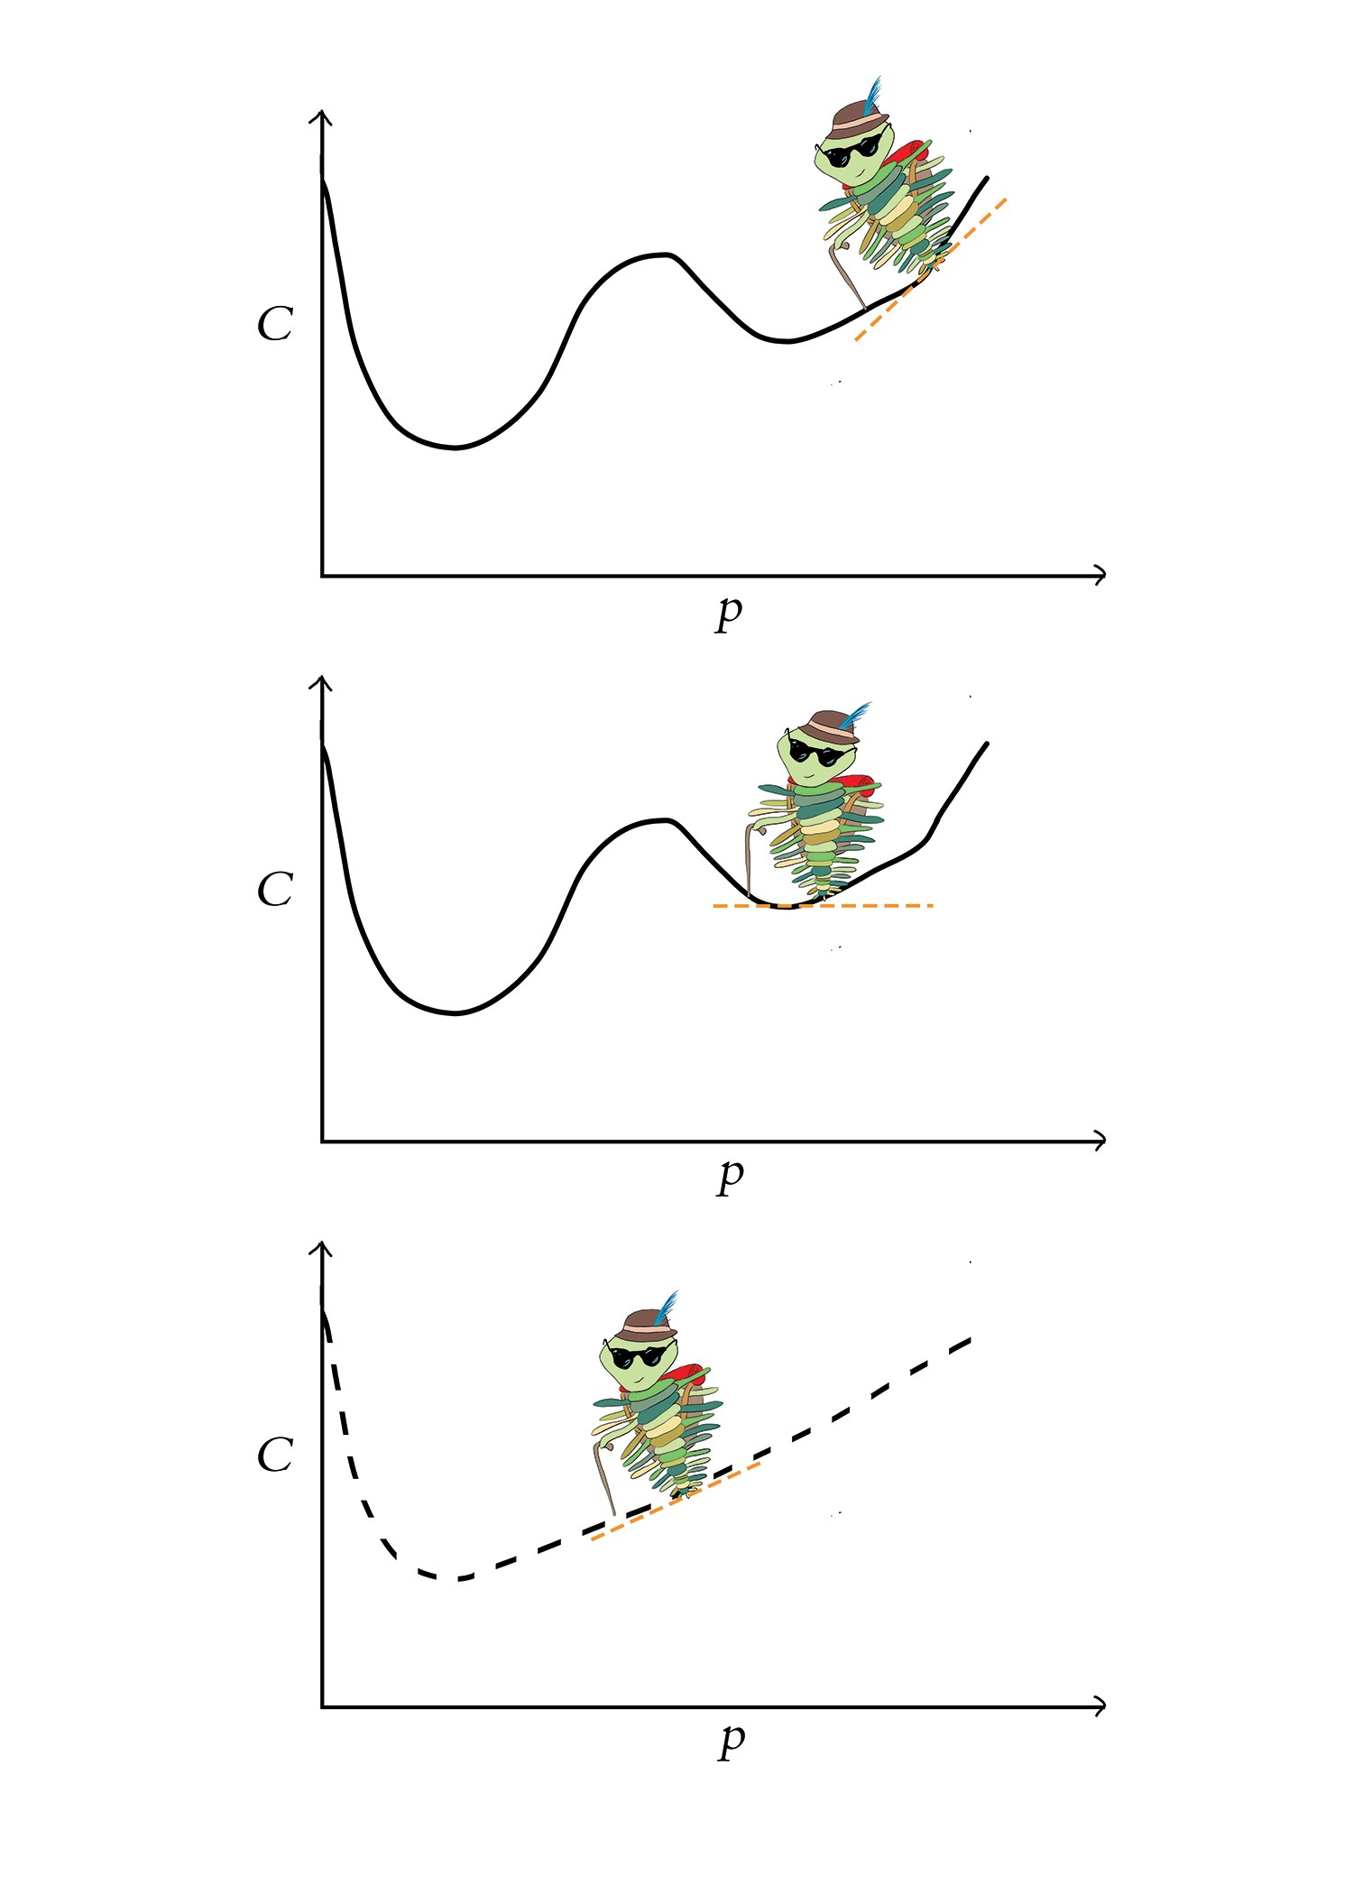
Chapter 9
Improving Deep Networks

Slide 3
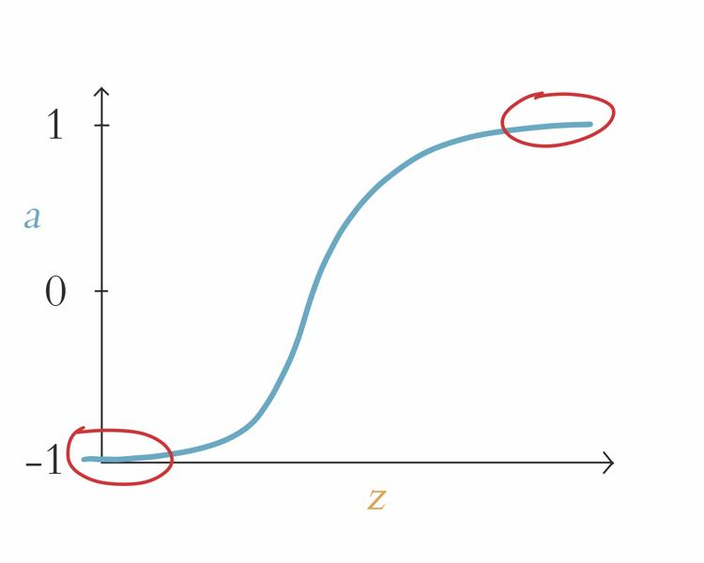
Neuron Saturation

Slide 4
Weight Initialization
The goal is to start with reasonably scaled values for w and b.
Large w & b values tend to result in large z values and therefore saturated neurons.
Large parameter values imply strong opinion on how x is related to y → BEFORE any training
Parameter values of zero imply weak relationship
Initialize b parameters with zeros.
Initialize w parameters with values near zero using Glorot distributions.

Slide 5
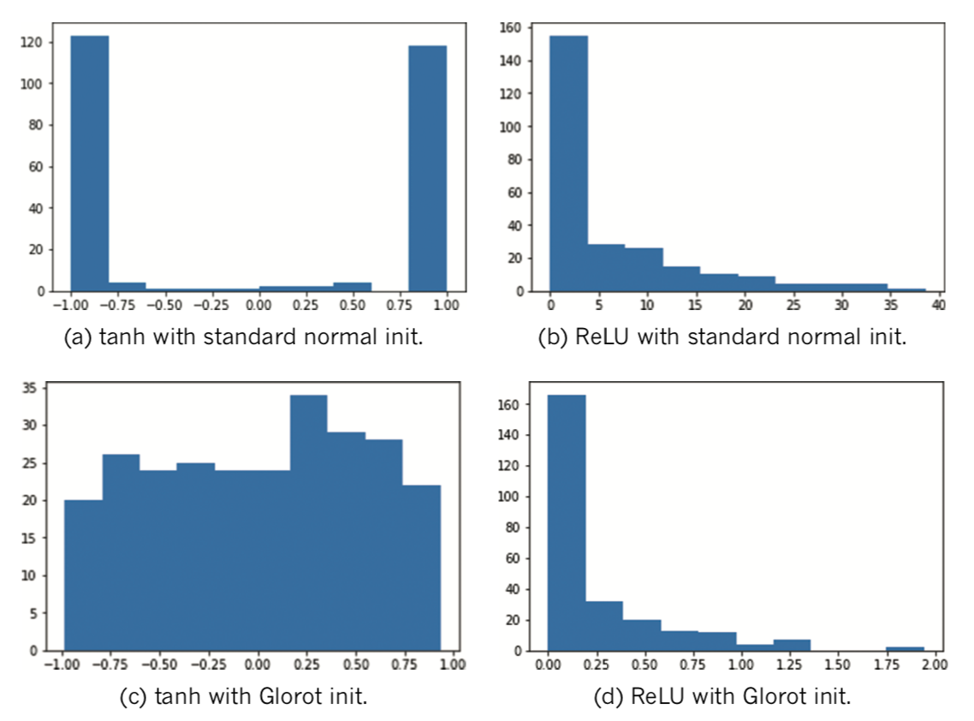
Weight Initializations

Slide 6
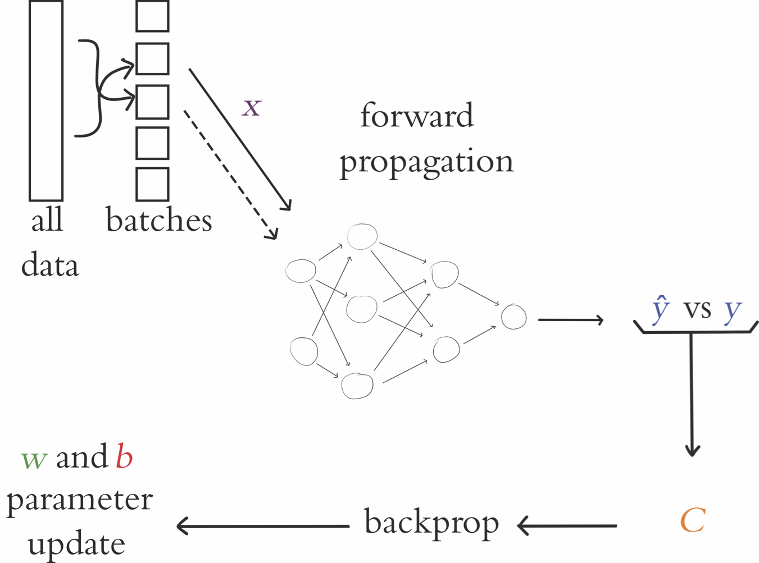
Stochastic Gradient Descent

Slide 7
Unstable Gradients
Recall: each parameter adjusted in proportion to its gradient with respect to cost C
Large & positive gradients imply parameter contributes large amount to cost C
Parameter / Cost relationship most direct in hidden layer closest to output
As we move from final hidden layer toward first hidden layer, gradient tends to flatten or vanish
Blindly adding more layers will amplify vanishing gradients
In some architectures, the gradient becomes steep as we move toward the first layer → exploding gradients

Slide 8
Batch Normalization
Recenters the distribution of activations (a) with mean 0 and std deviation of 1
Extreme values in preceding layer won’t cause unstable gradients in next layer
Allows layers to learn independently from each other.
Allows for higher learning rate and thus faster learning.
Improves generalization performance by adding noise element which contributes to regularization.
Adds 2 learnable parameters: gamma and beta
Since they are learnable, the network will adjust them on a layer-by-layer basis depending on what is most helpful.

Slide 9
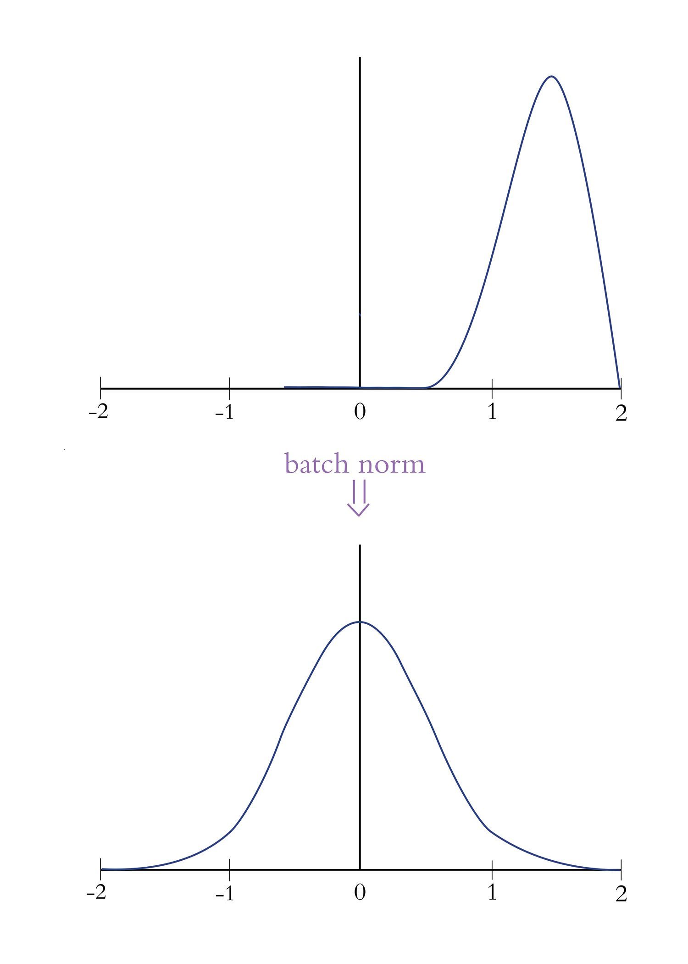
Batch Normalization

Slide 10
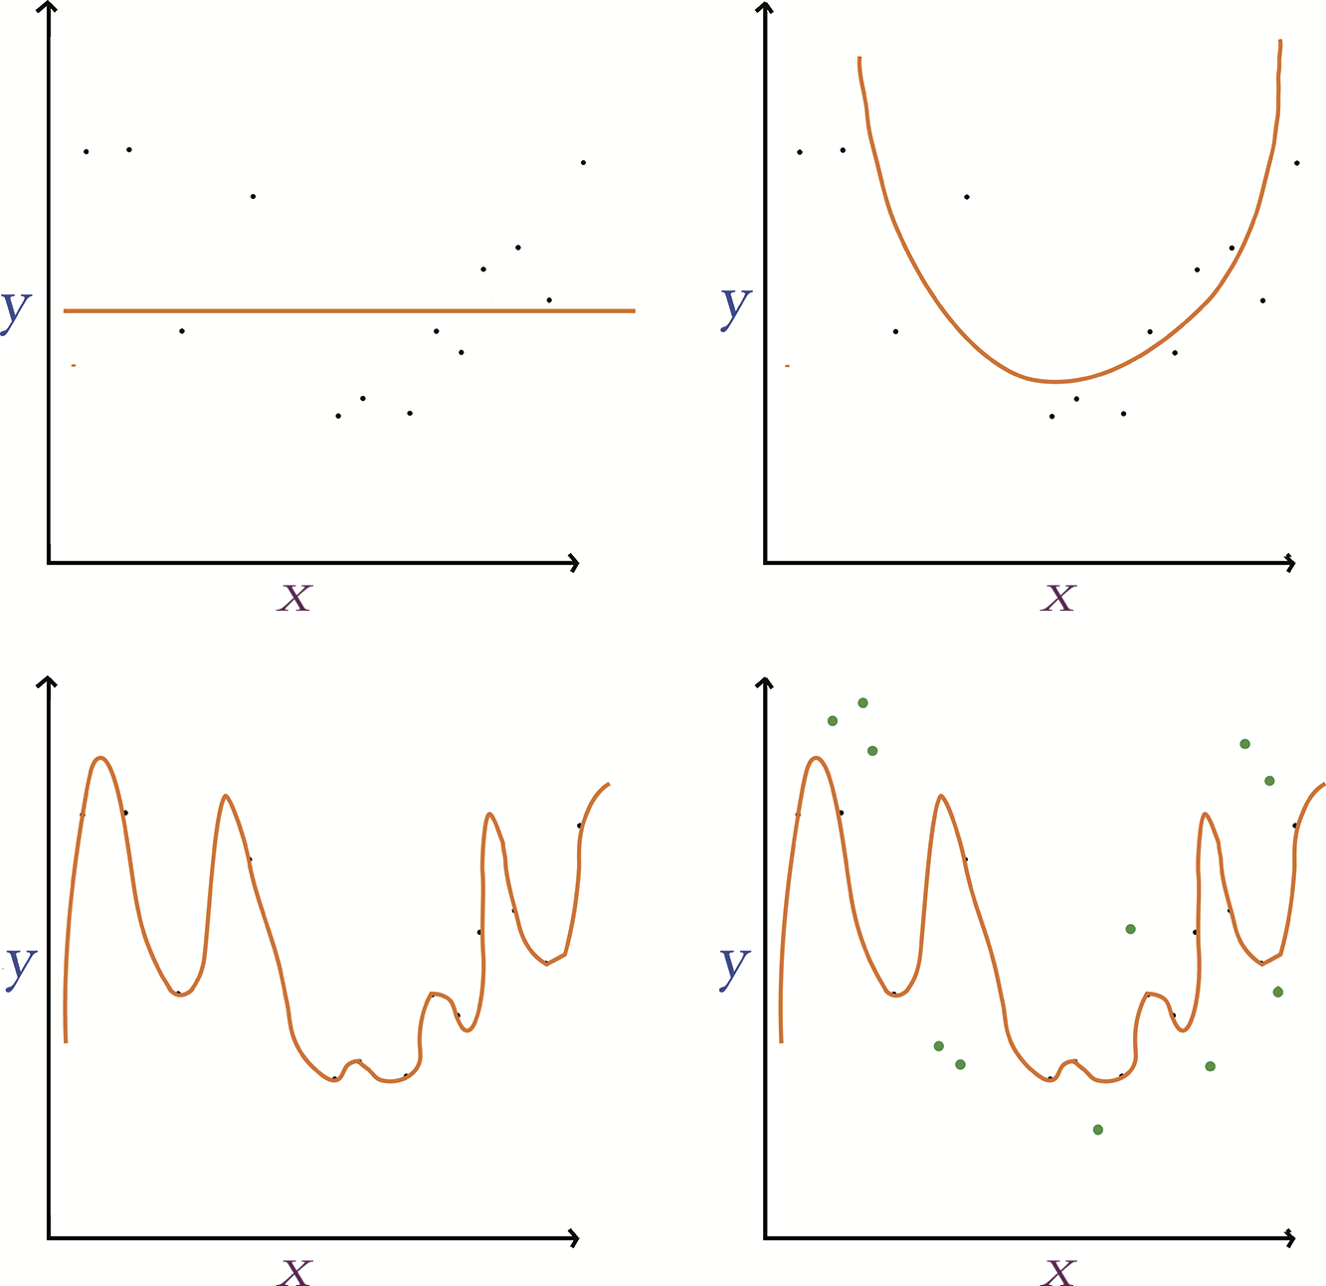
Underfitting and Overfitting

Slide 11
Regularization Techniques
L1/L2 regularization
LASSO and Ridge regression
Dropout
Pretends randomly selected proportion of neurons in each later do not exist during each round of training
Data augmentation
Generate new training data from existing → artificially expanding training data set.

Slide 12
Dropout
Dropout
Pretends randomly selected proportion of neurons in each later do not exist during each round of training.
Prevents single neuron from becoming excessively influential
Parameter-adjustment needed during validation and inference → Keras handles automatically
Dropout rate is hyperparameter: consider adding in later layers of the network.
See page 144 for parameter tuning details

Slide 13
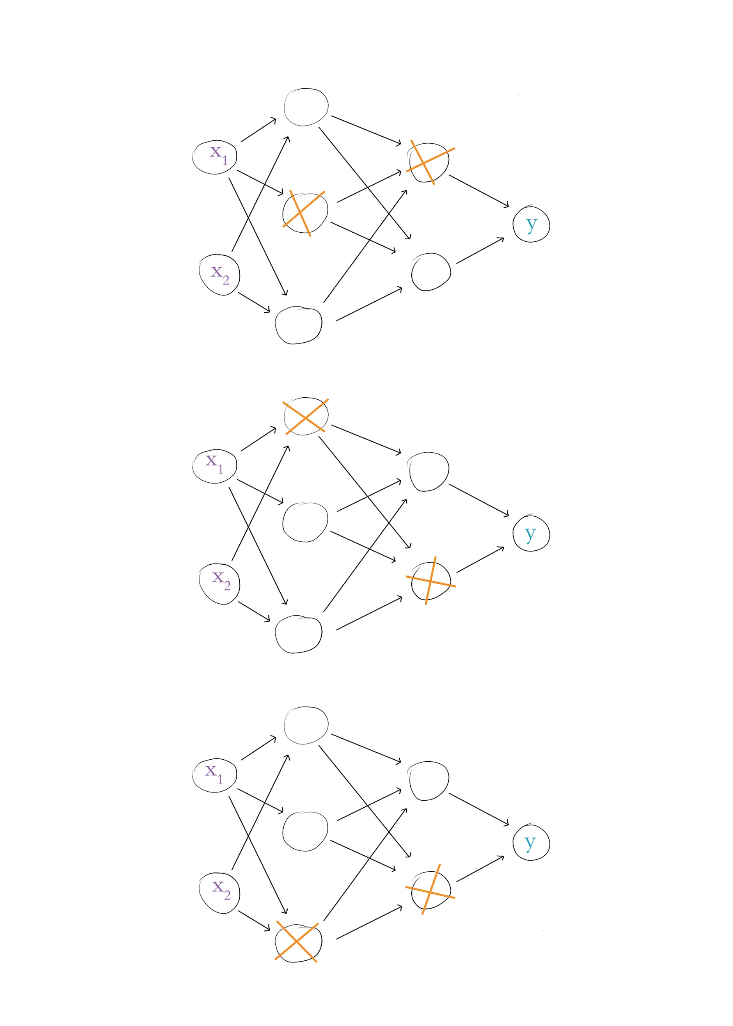
Dropout

Slide 15
Fancy Optimizers
Momentum
Nesterov Momentum
AdaGrad
AdaDelta
RMSProp
Adam
Nadam

Slide 16
Momentum
Moving average of gradients for each parameter used to update weights.
Additional hyperparameter Beta controls how many previous gradients involved in the moving average.
Small Betas allow older gradients to be considered
Larger Betas generally better, with 0.9 as default.

Slide 17
Nesterov Momentum
Takes peek at where momentum may take us.
Uses sneak-peek to execute step from original position.
Trilobite aware of speed, guessing where momentum may take it, and adjusting course accordingly.

Slide 18
AdaGrad
Learning rate for each parameter allows for slowing or halting learning after parameter reaches or nears optimum.
Uses hyperparameter epsilon – safely leave at default.
Allows the learning rate to be set at default and left alone.
One downside is learning rate can shrink significantly with larger past gradient matrices, slowing learning to a halt.

Slide 19
AdaDelta & RMSProp
AdaDelta addresses the gradient matrix size concern of AdaGrad by using MA of previous gradients.
AdaDelta removes the need for learning rate.
RMSProp works similar to AdaDelta but maintains LR.
Both AdaDelta & RMSProp utilize decay rate (rho) hyperparameter which is similar to B in momentum.
Recommended Defaults:
Decay rate (rho) = 0.95
Learning rate = 0.001 for RMSProp

Slide 20
Adaptive Moment Estimation (Adam)
Essentially RMSProp with following exceptions:
Extra MA is used to inform parameter updates as opposed to actual gradients.
Bias trick used to prevent MAs from skewing toward zero.
Hyperparameters
Two B’s: B1=0.9 & B2=0.999.
Learning rate: set at 0.001 and leave it.

Slide 21
Optimizer Wrap-Up
Adam is very popular.
SGD with Momentum is solid and may perform better.
EXPERIMENT to determine what works best for your model architecture and data.

Slide 22
Running TensorBoard
Add to Python code:
from tensorflow.keras.callbacks import TensorBoard
tensorboard = TensorBoard(log_dir=’logs/run-name’)
callbacks = [tensorboard] in model.fit() step
In Terminal, run: tensorboard --logdir='logs/' --port 6006
Visit localhost:6006 in your favorite browser
tensorboard_in_notebooks.ipynb - Colaboratory (google.com)

